Slide 1
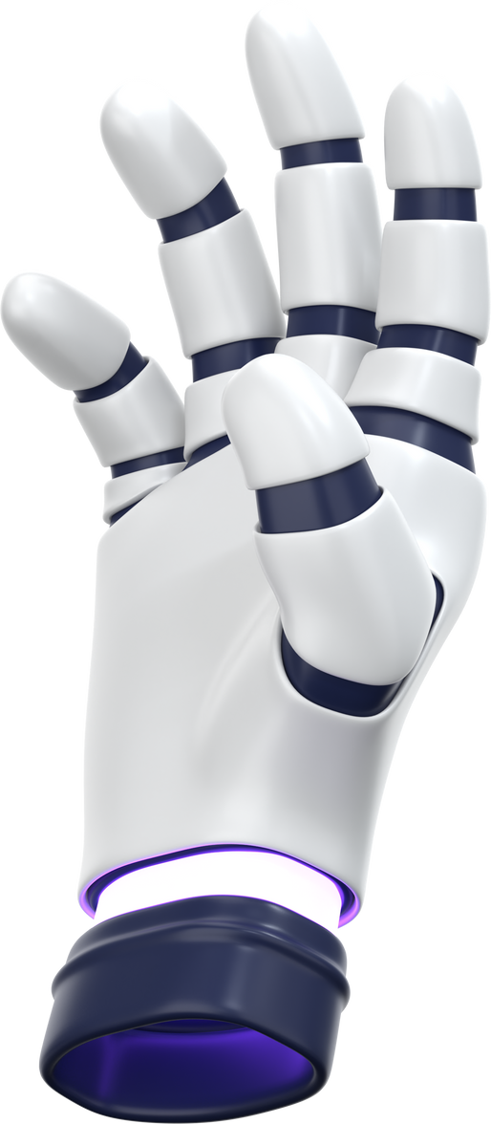
FRUIT RECOGNITION PROJECT

Slide 2


OBJECTIVES AND CHALLENGES OF THE PROJECT
The goal of this project is to build a fruit recognition system using images and compare Classical Machine Learning with Deep Learning approaches. Different classifiers are evaluated to measure their performance. The main challenge is accurately classifying 10 different types of fruits

Slide 3

DATASET
  Source: Hugging Face (ysif9/fruit-recognition)
  10 Fruit: Classes:
Apple, Banana, Orange, Mango, Grapes
Pineapple, Watermelon, Pomegranate, Strawberry,
Lemon
  Data Split:
Training set (80%)
Validation set (10%)
Test set (10%)

Slide 4

01.
Image Resizing
224×224 for Deep Learning models and 96×96 for Classical Machine Learning
PREPROCESSING
STEPS
02.
Normalization
Scaled pixel values to [0,1] range
03.
Data Augmentation
Random flips & Random rotations

Slide 5

FEATURE EXTRACTION
  Method Used: MobileNetV2 (pre-trained on ImageNet)
  Process:
Converted images to 1280-dimensional feature vectors
Applied dimensionality reduction (LDA & PCA)
Reduced features for better performance

Slide 6

MODELS TESTED
K-Nearest Neighbors (KNN)
02.
Support Vector Machine (SVM)
01.
Classifies fruits by finding the 5 most similar images in the training set based
uses an RBF kernel to find the optimal
decision boundary
03.
Decision Tree
Makes classification decisions by
asking a series of yes/no questions
about image features

Slide 7
MODELS TESTED
04.
Random Forest
05.
XGBoost
Builds trees sequentially where each new tree corrects the mistakes made by previous trees using gradient boosting optimization.
Combines predictions from 200
individual decision trees
06.
ANN
MobileNetV2 was used with transfer learning and achieved higher accuracy

Slide 8
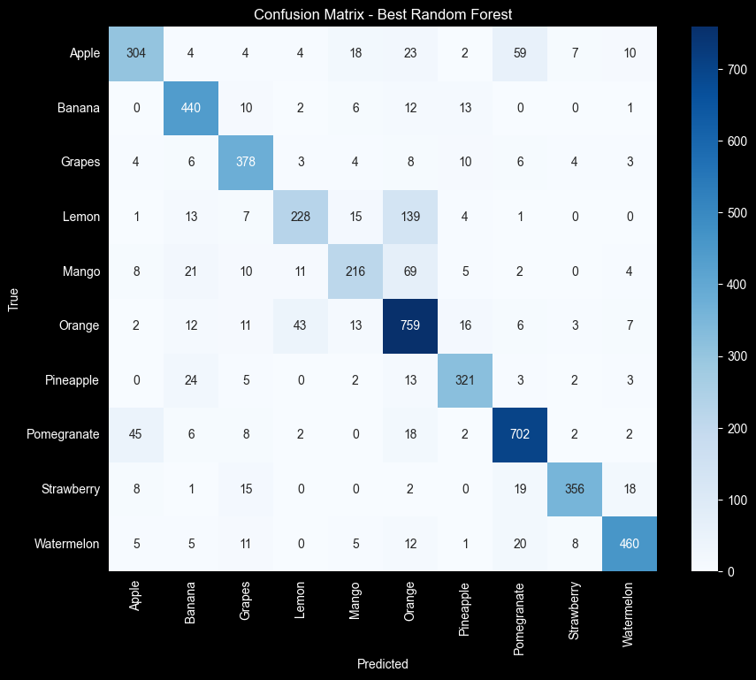

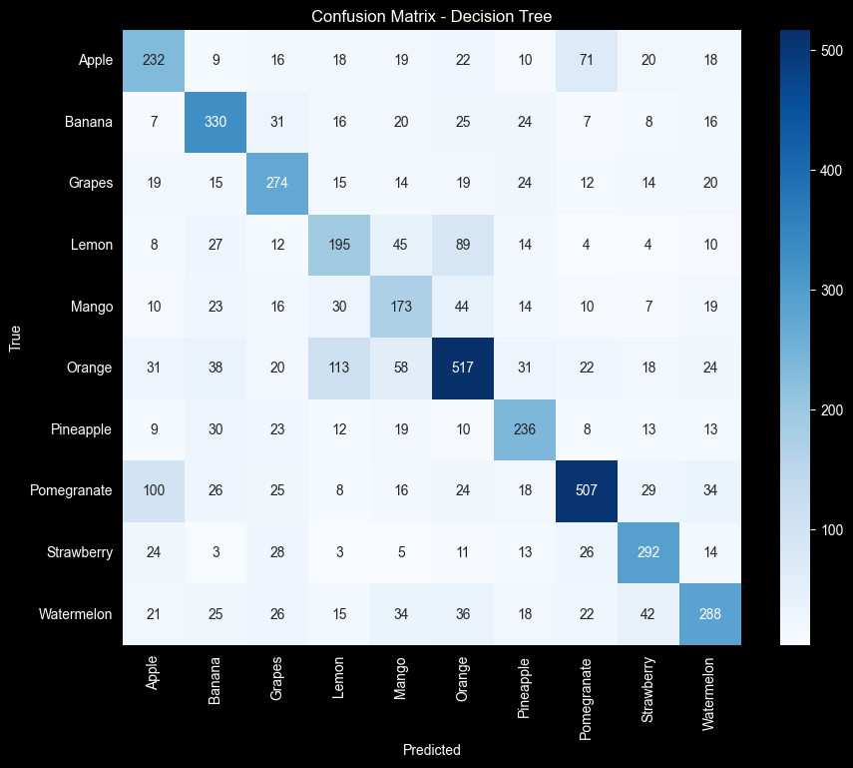
CONFUSION MATRICES
RF
XGBOOST
DT

Slide 9
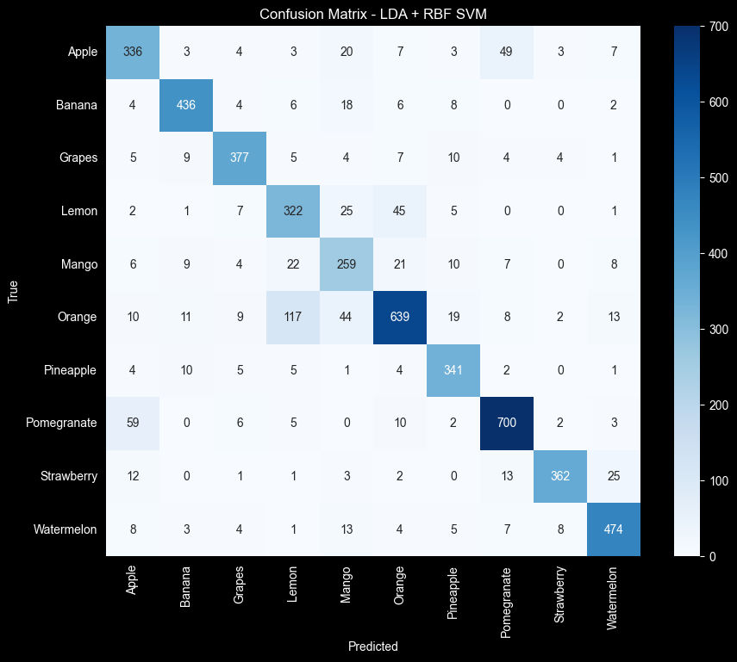
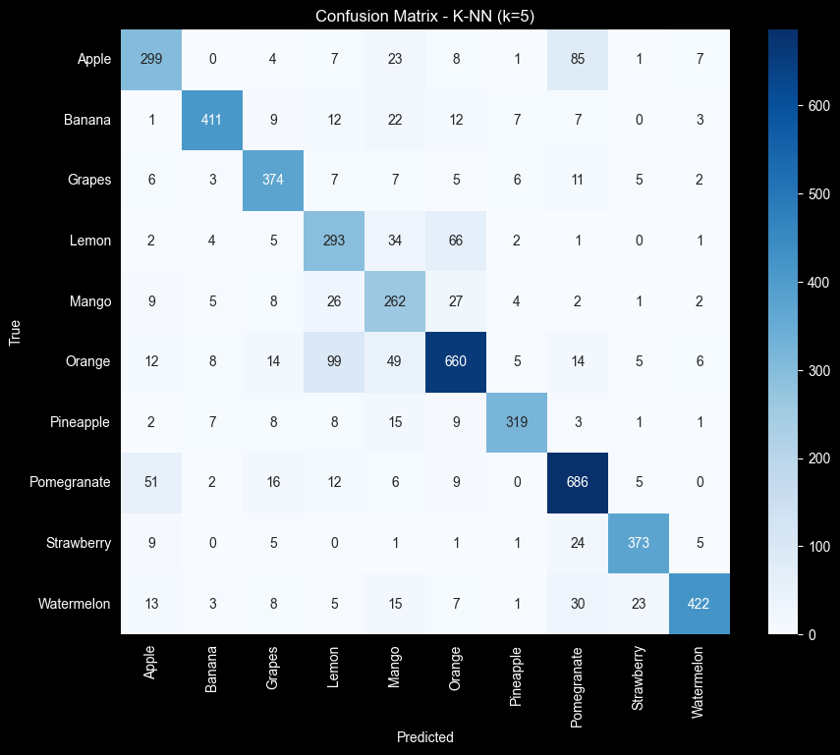
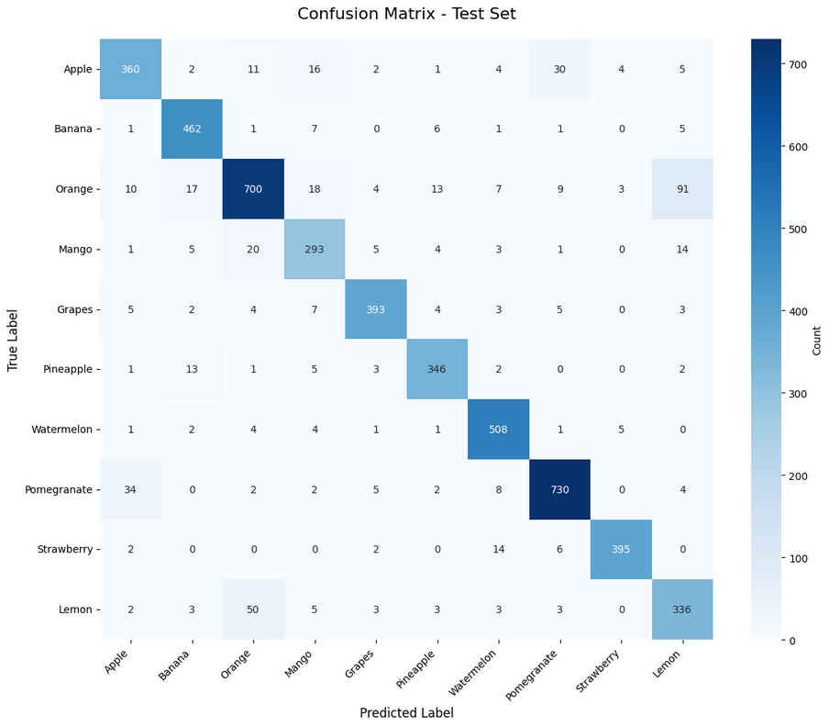
CONFUSION MATRICES 2
SVM
KNN
ANN

Slide 10
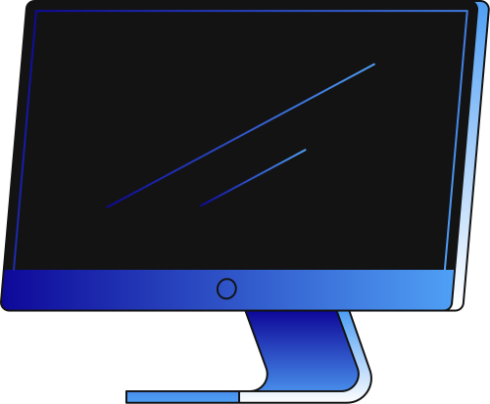
KEY FINDINGS AND MODEL COMPARISON
  SVM achieved the highest accuracy among classical classification models while providing a good balance between high accuracy, lower training time, and reduced computational cost.
  Decision Tree showed the weakest performance.
  ANN achieved the overall best accuracy, but it required more time and higher computational resources.

Slide 11
CONCLUSION
we successfully compared seven machine learning models for fruit classification and gained valuable insights into their performance. The results showed that classical machine learning approaches can compete with Deep Learning when features are effective. The developed system is capable of accurately classifying 10 different fruit types and is ready for further development and real-world testing.

Slide 12

THANK
YOU.
Presented by:
  Sandra Ghayes Zarif 22P0300
  Yousif Salah Mohammed 22P0232

